Slide 1
Quantization

Slide 2
Topics
Floating-Point Representation
Quantization mapping
Quantized Matrix Multiplication
MAC Integer Operations
Back to float
Quantized Layers
Post-training Quantization

Slide 3
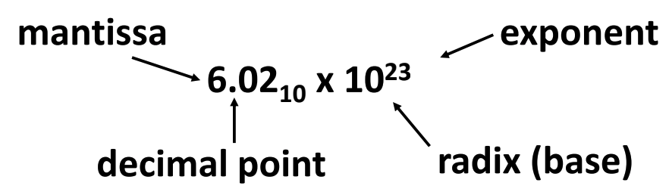
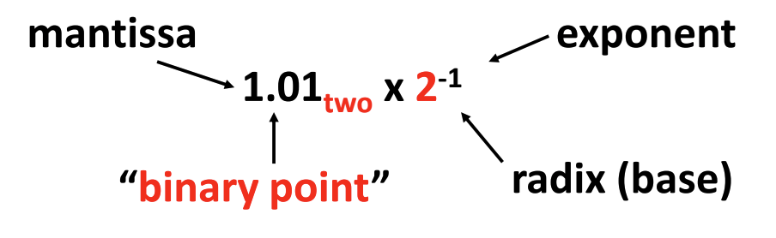
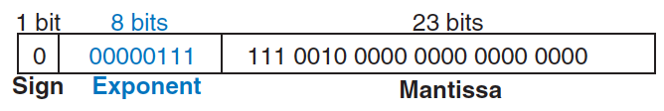
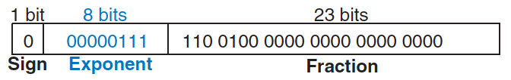
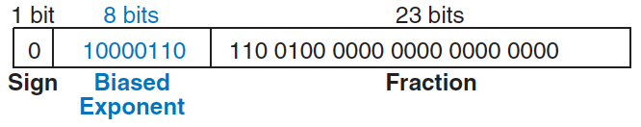
Floating-Point Representation
Analogous to scientific notation
have a sign, mantissa (M), base (B), and exponent (E)
allowing the representation of very large and very small number
IEEE 754 floating-point standard (FP32)
base 2, 1 sign bit, 8 exponent bits, and 23 mantissa bits
228₁₀ = 11100100₂ = 1.11001*2⁷ = 1.11001*2⁰⁰⁰⁰⁰¹¹¹
notice: first bit of mantissa is always 1 and therefore need not be stored (implicit leading one)
exponent needs to represent both positive and negative exponents: use a biased exponent (127)
Decimal
Binary

Slide 4
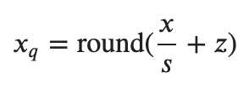
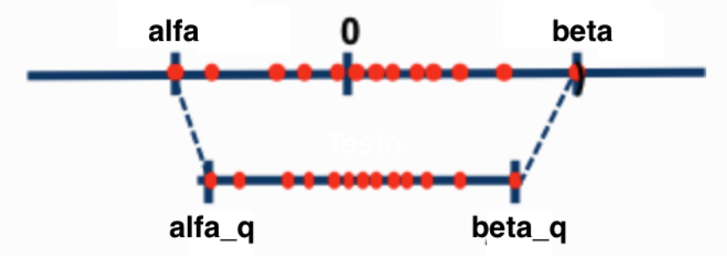

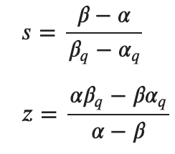
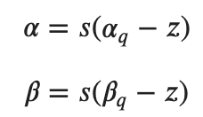
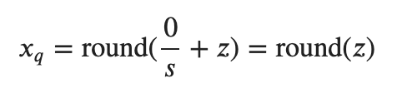
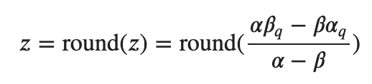
Quantization mapping (1)
Mapping a floating point value 𝑥 ∈ [𝛼, 𝛽] to a b-bit integer 𝑥_{𝑞} ∈ [𝛼_{𝑞}, 𝛽_{𝑞}]
Parameters s (scale) and z (zero point) assure that 𝛼_{𝑞} maps to 𝛼 and 𝛽_{𝑞} maps to 𝛽
In practice, we have to ensure that 0 in floating point is represented exactly with no error after quantization, mathematically we need to ensure:

Slide 5


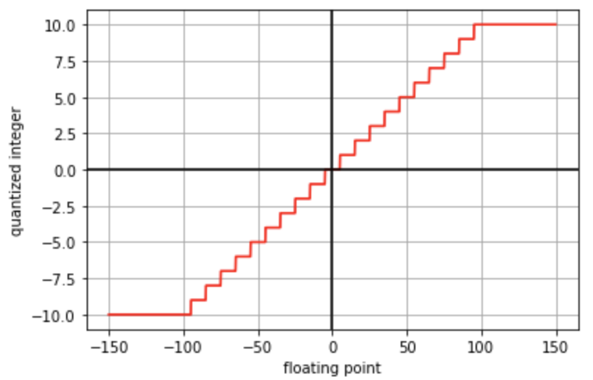
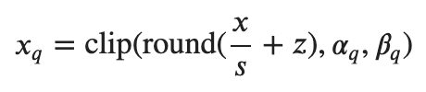
Quantization mapping (2)
If the integer type is signed INTb
Else, if the integer type is unsigned UINTb:
In practice, will have chances to have 𝑥 outside the range thus the quantized value 𝑥_{𝑞} will also be outside its range
we have to add an additional clip step
See “quantization-mapping.ipynb” notebook
There are other ways of quantization mapping, potentially even non-linear

Slide 6

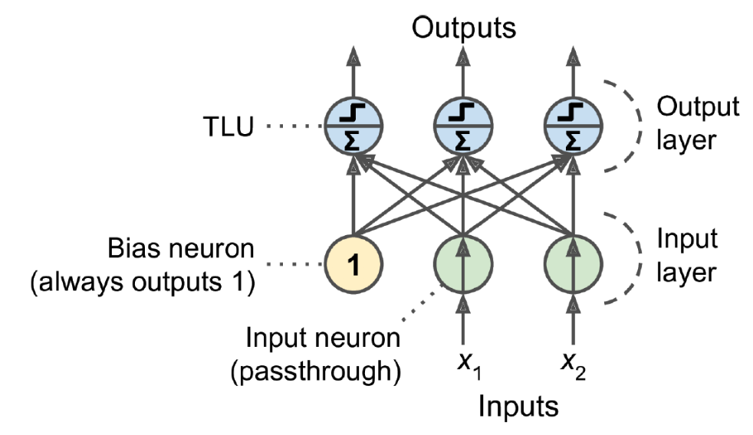
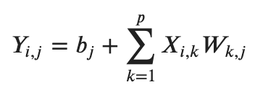
Quantized Matrix Multiplication (1)
Consider the typical matrix multiplication of a fully connected layer
𝑋 ∈ 𝑅^{𝑚×𝑝} is the matrix of input and it has one row per instance (𝑚) and one column per feature (𝑝)
𝑊 ∈ 𝑅^{𝑝×𝑛} is the weight matrix, it contains the connection weights between input neurons and neurons, it has one row per feature (𝑝) and one column per neuron in the layer (𝑛)
𝑏 ∈ 𝑅^{𝑛} is the bias vector, it contains the connection weights between bias neurons and neurons. It has one term per neuron (𝑛)
resulting in 𝑌 ∈ 𝑅^{𝑚×𝑛} that as one row per instance (𝑚) and one column per neuron (𝑛)
We would need to do 𝑝 floating point multiplications and 𝑝 floating point additions to compute one single entry in 𝑌
To complete the full matrix Y, given there are (𝑚⋅𝑛) entries, we need to do (𝑚⋅𝑛⋅𝑝) floating point multiplications and additions

Slide 7
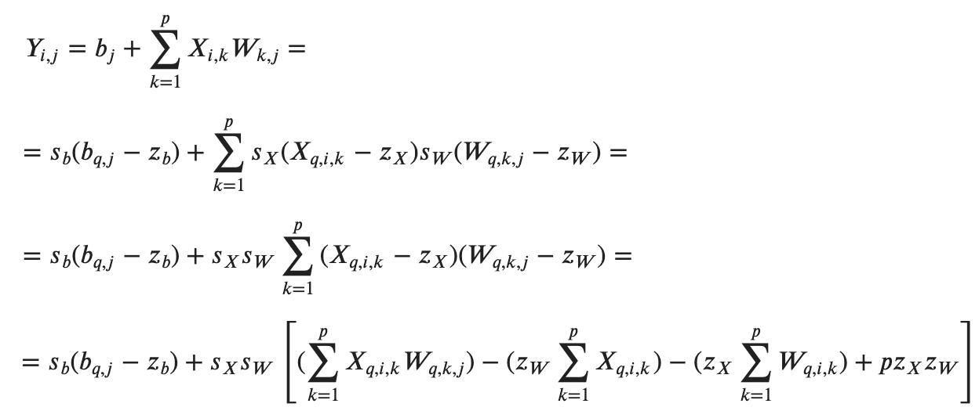

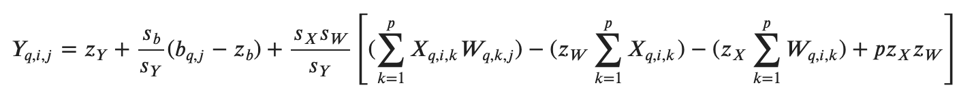
Quantized Matrix Multiplication (2)
Can we compute the same matrix using quantized values?
We can also express the same operation with quantized matrix 𝑌_{𝑞}
Therefore

Slide 8
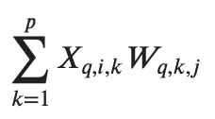
MAC Operations
Several terms are constant during the inference
don't depend on the particular input and can be computed offline
The term
suggests that we can do the integer matrix multiplication for 𝑋_{𝑞} and 𝑊_{𝑞} employing special hardware and algorithms
NVIDIA Tensor Core IMMA operations
Integer Matrix Multiply and Accumulate operation

Slide 9
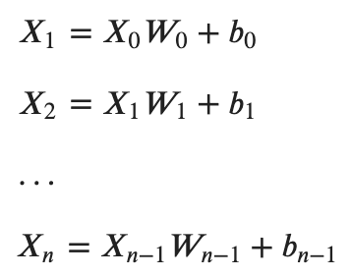
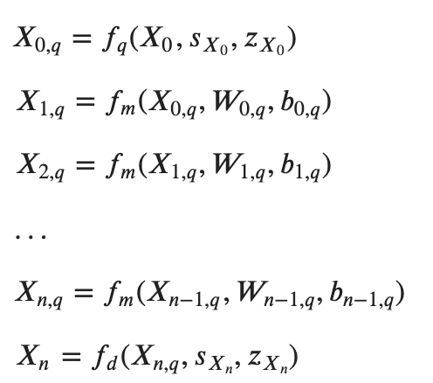
Back to float
Consider a sequence of matrix multiplications (like in ANN inference), whose inputs and outputs are floating point:
We can convert the math using the quantized matrices:
See “quantized-multiplication.ipynb” notebook
Where
𝑓_{𝑞} is the quantization function
𝑓_{𝑚} is the quantized matrix multiplication function
𝑓_{𝑑} is the de-quantization function

Slide 10
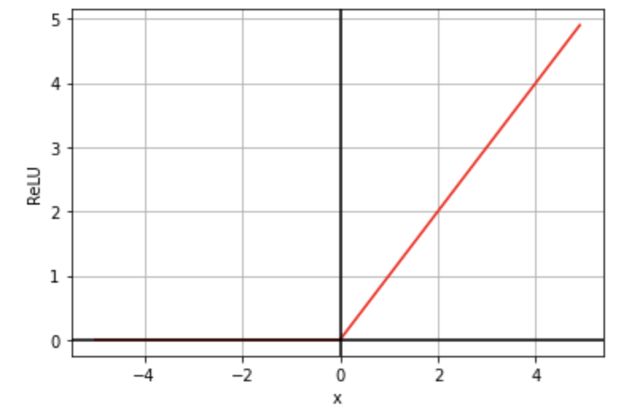
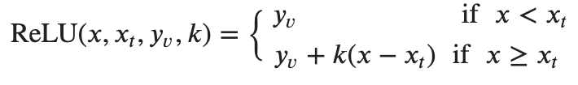
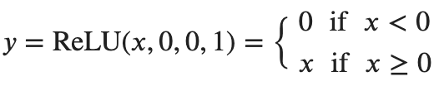
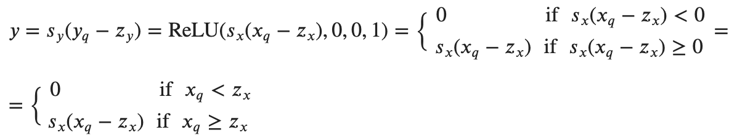
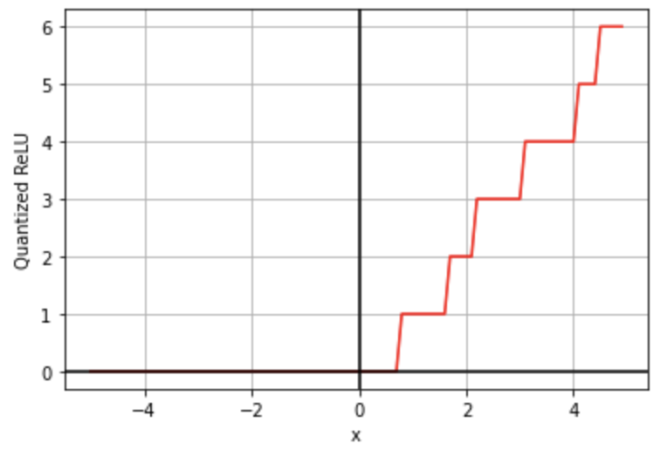
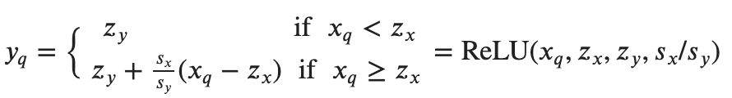
Quantized Layers
How do we deal with special layers (e.g. non-linear activation layers) in a quantized DNN?
Consider the ReLU activation function
general form:
common ReLU: 𝑥_{𝑡}=0, 𝑦_{𝑣}=0, 𝑘=1
Let’s derive the quantized ReLU mathematically:
Therefore:
See “quantized-relu.ipynb” notebook

Slide 11
Post-training Quantization
Quantization performed on already trained models
without developing a new model architecture
start with an existing FP model and quantize it to obtain a fixed point quantized model
without needing to re-train
Several benefit:
generally model size reduction is a factor of 4
less working memory needed (due to the reduction on the precision of data)
faster processing of 8-bit data (most processors)
lower power consumption (due to the reduction in the data movement)
All the factors above translate into faster inference
typical speedup of 2-3x due to the reduced precision for both memory accesses and computations
The cost is usually modest decrease in accuracy
See “post-training-quantization.ipynb” notebook

Slide 12
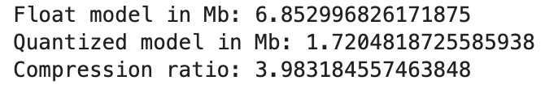
Post-training Quantization (2)
Dynamic Range Quantization
statically quantizes the weights from floating point to 8-bits of precision
dynamically quantizes the activations at inference
activations are always stored in float 32
converted to 8-bit integers while processing
back to floating point after the processing is done
Static Quantization
pre-computes scales and zero points also for all the activation tensors
overhead of this computation is eliminated.
run the NN using some representative unlabelled data, collect the distribution statistics for all the activation layers
use the distribution statistics to compute the scales and zero points

Slide 13

Quantization Aware Training (1)
Quantization introduces information loss
floating point numbers after quantization and de-quantization is not exactly recoverable
inference accuracies are inevitably lower
The idea is to ask the neural networks to take the effect of such information loss into account during training
we add a quantization and a de-quantization layer for each of the tensors
scale and zero point could be collected like in static quantization
training is supposed to be done normally, as if the quantization and de-quantization layers were not existed

Slide 14
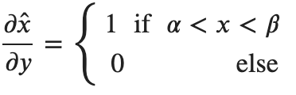
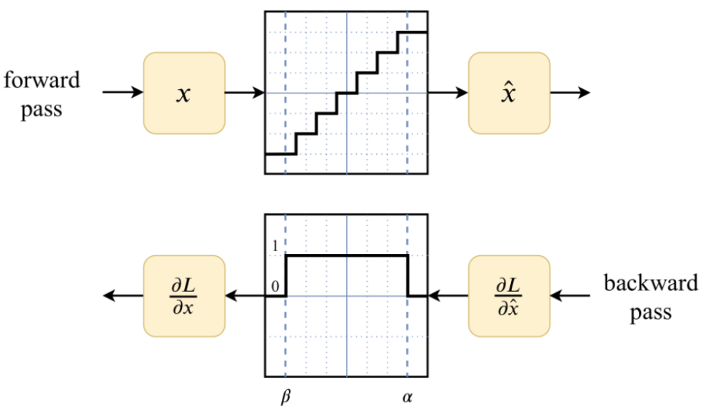
Quantization Aware Training (2)
Problem: such quantization and de-quantization layers are not differentiable
Straight through estimation (STE) derivative approximation
treat quantization functions as if they are identity function in the clipping range [𝛼,𝛽] and constant outside
so derivatives are 1 in the clippings range and 0 outside
Typically provides higher accuracies as compared to post-training quantization.
See “quantization-aware-training.ipynb” notebook

